Slide 1
Chapter 3
Understanding Cloud Architecture

Slide 2
Learning Objectives
Using the cloud computing stack to describe different models
Understanding how platforms and virtual appliances are used
Learning how cloud communications work
Discovering the new world of the cloud client

Slide 3
Exploring the Cloud Computing Stack
Cloud computing builds on the architecture developed for staging large distributed network applications on the Internet over the last 20 years, adds the advances in system virtualization that became available over the last decade.
The cloud creates a system where resources can be pooled and partitioned as needed.
Cloud architecture can couple software running on virtualized hardware in multiple locations to provide an on-demand service to user-facing hardware and software.

Slide 4
Exploring the Cloud Computing Stack
Cloud computing can be described in term of two architecture layers:
A client as a front-end
The “cloud” as the back-end
Two components is composed of several component layers, complementary functionalities, and a mixture of standard and proprietary protocols.
Cloud computing may encapsulated information technology service that is often controlled through an Application Programming Interface (API), thus modifying the services that are delivered over the network.

Slide 5
Exploring the Cloud Computing Stack
A cloud can be created within an organization's own infrastructure or outsourced to another datacenter.
Resources in a cloud often are virtualized resources because virtualized resources are easier to modify and optimize. A compute cloud requires virtualized storage to support the staging and storage of data.
From a user's perspective, it is important that the resources appear to be infinitely scalable, that the service be measurable, and that the pricing be metered.

Slide 6
Composability
Applications built in the cloud often have the property of being built from a collection of components, a feature referred to as composability
A composable component must be:
Modular: It is a self-contained and independent unit that is cooperative, reusable, and replaceable.
Stateless: A transaction is executed without regard to other transactions or requests.

Slide 7
Composability
Cloud computing doesn't require that hardware and software be composable, but it’s more desireable from a developer or user's standpoint it
From the standpoint of an IaaS (Infrastructure as a Service) vendor such as Amazon Web Services, GoGrid, or Rackspace, it makes no sense to offer non-standard machine instances to customers, because those customers are almost certainly deploying applications built on standard operating systems such as Linux, Windows, Solaris, or some other well-known operating system.

Slide 8
Composability
PaaS (Platform as a Service) vendors such as Windows Azure or Google AppEngine may narrow the definition of standard parts to standard parts that work with their own platforms, but at least from the standpoint of the individual platform service provider, the intent is to be modular for their own developers.
SaaS (Software as a Service), the notion of composability for users may completely disappear.

Slide 9
Composability
A PaaS or SaaS service provider gets the same benefits from a composable system that a user does these things, among others:
Easier to assemble systems
Cheaper system development
More reliable operation
A larger pool of qualified developers
A logical design methodology

Slide 10
Composability
Modules can be written in any programming language the developer wants.
From the standpoint of the system, the module is a black box, and only the interface is well specified.

Slide 11
Infrastructure
Most large Infrastructure as a Service (IaaS) providers rely on virtual machine technology to deliver servers that can run applications.
Virtual servers described in terms of a machine image or instance have characteristics that often can be described in terms of real servers delivering a certain number of microprocessor (CPU) cycles, memory access, and network bandwidth to customers.
Virtual machines are containers that are assigned specific resources. The software that runs in the virtual machines is what defines the utility of the cloud computing system.

Slide 12
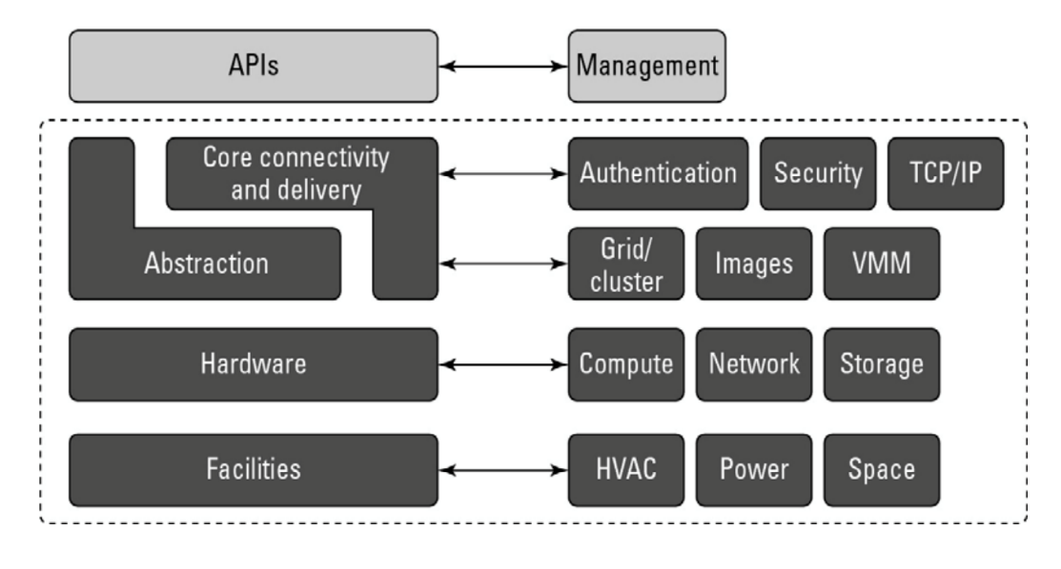
Infrastructure

Slide 13
Infrastructure
The notion of a virtual server presents to an application developer a new way of thinking about and programming applications.
In future applications, developers will need to balance the architectural needs of their programs so their applications create new threads when it is appropriate or create new virtual machines.

Slide 14
Platforms
A platform in the cloud is a software layer that is used to create higher levels of service.
For example:
Salesforce.com's Force.com Platform
Windows Azure Platform
Google Apps and the Google AppEngine

Slide 15
Platforms
These services offer all the hosted hardware and software needed to build and deploy Web applications or services that are custom built by the developer within the context and range of capabilities that the platform allows.
Platforms represent nearly the full cloud software stack, missing only the presentation layer that represents the user interface.

Slide 16
Platforms
Platforms often come replete with tools and utilities to aid in application design and deployment.
Depending upon the vendor, you may find developer tools for team collaboration, testing tools, instrumentation for measuring program performance and attributes, versioning, database and Web service integration, and storage tools.
Most platforms begin by establishing a developer community to support the work done in the environment.

Slide 17
Platforms
Users interact with the platform, consuming services through API, leaving the platform to manage and scale the service appropriately.
Many platforms offer user interface development tools based on HTML, JavaScript, or some other technology.

Slide 18
Virtual Appliances
Virtual appliances are software installed on virtual servers—application modules that are meant to run a particular machine instance or image type. A virtual appliance is a platform instance. Therefore, virtual appliances occupy the middle of the cloud computing stack.

Slide 19
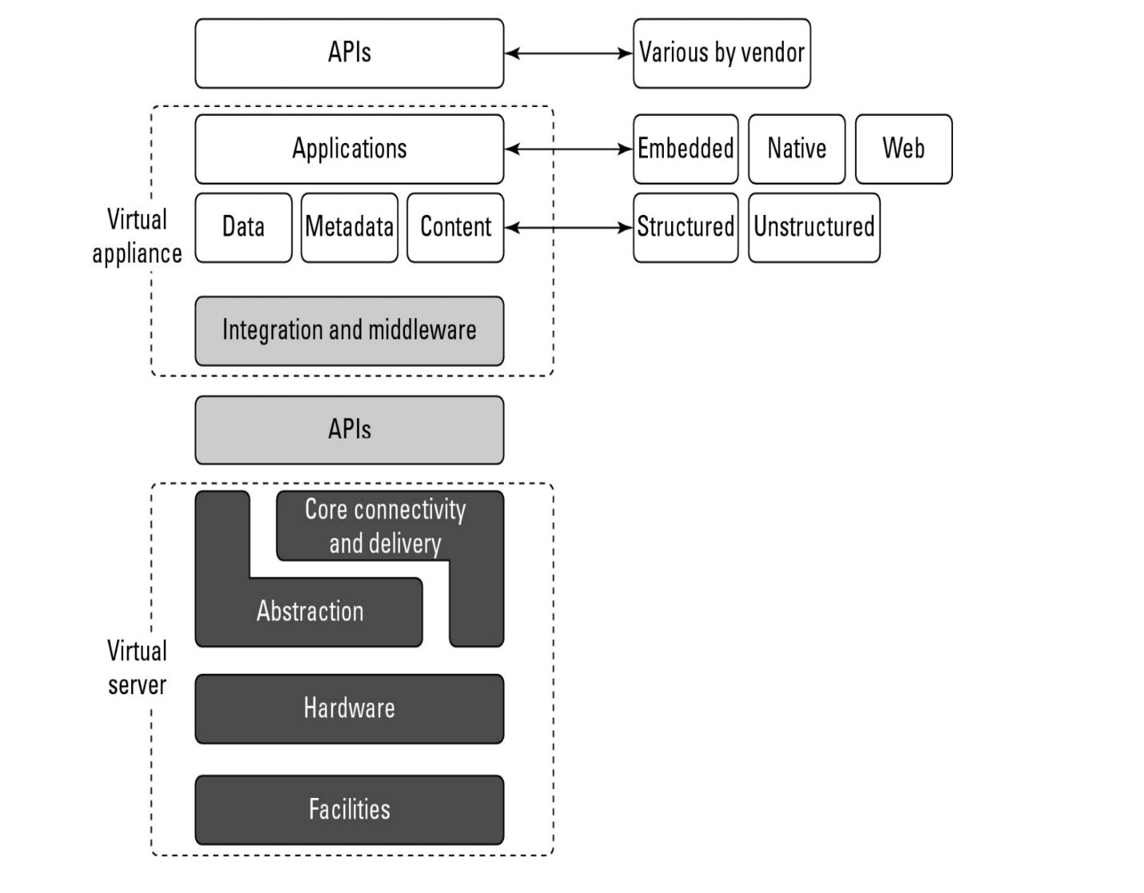
Virtual Appliances

Slide 20
Virtual Appliances
A virtual appliance is a common deployment object in the cloud, and it is one area where there is considerable activity and innovation.
One of the major advantages of a virtual appliance is that you can use the appliances as the basis for assembling more complex services, the appliance being one of your standardized components.
Virtual appliances remove the need for application configuration and maintenance from your list of system management chores.

Slide 21
Virtual Appliances
Virtual appliances are far easier to install and run than an application that you must set up yourself. However, virtual appliances are also much larger than the application themselves would be because they are usually bundled with the operating system on which they are meant to run.
An application that is 50 or 100MB might require a virtual appliance that is 500MB to 1GB in size. Usually, when a virtual appliance is created, the operating system is stripped of all excess functionality that isn't required by the appliance, because the appliance is meant to be used as is.

Slide 22
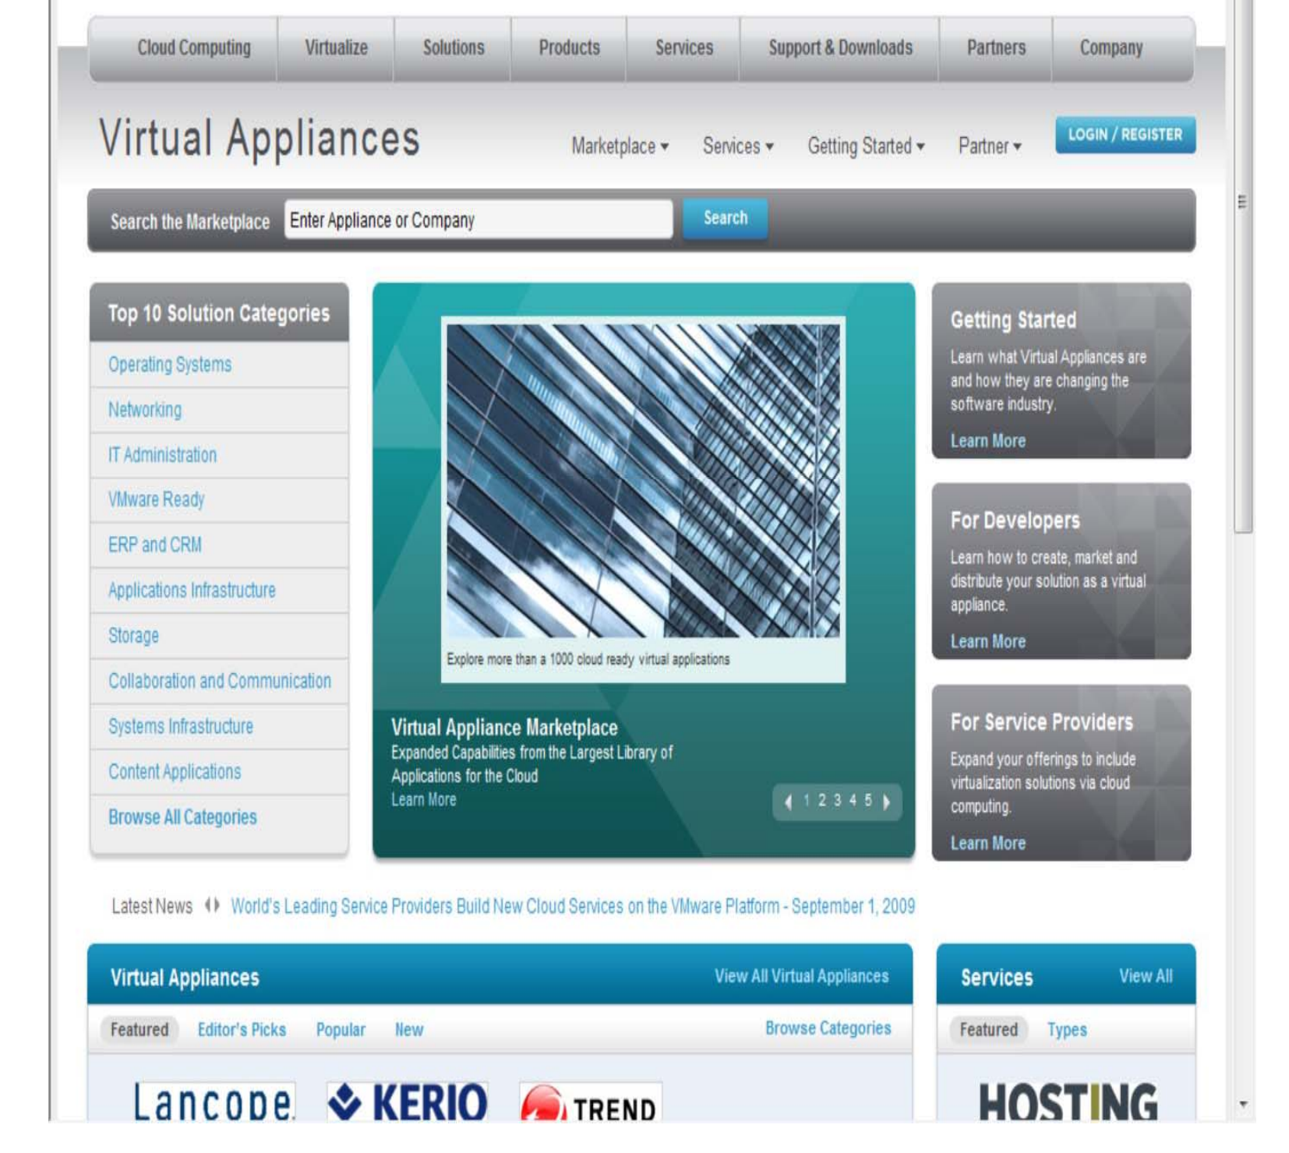

Slide 23
Communication Protocols
Cloud computing arises from services available over the Internet communicating using the standard Internet protocol suite underpinned by the HTTP and HTTPS transfer protocols. The other protocols and standards that expose compute and data resources in the cloud either format data or communications in packets that are sent over these two transport protocols.

Slide 24
Communication Protocols
In order to engage in interprocess communication (IPC) processes, many client/server protocols have been applied to distributed networking over the years.
Various forms of RPC (Remote Procedure Call) implementations (including DCOM, Java RMI, and CORBA) attempt to solve the problem of engaging services and managing transactions over what is essentially a stateless network.
The first of the truly Web-centric RPC technologies was XML-RPC, which uses platform-independent XML data to encode program calls that are transported over HTTP, the networking transport to which nearly everyone is connected.

Slide 25
Communication Protocols
The most widely used message-passing standard at the moment is the Simple Object Access Protocol (SOAP), which essentially replaces XML-RPC. SOAP uses XML for its messages and uses RPC and HTTP for message passing. SOAP forms the basis for most of the Web services stacks in use today.

Slide 26
Communication Protocols
Web Services Description Language (WSDL) commonly used model for discovery and description used with SOAP
WSDL lets a Web service advertise itself in terms of a collection of endpoints or ports associated with a specific network address (URL) that can be addressed using XML messages to provide a service.
In WSDL, a service is a container that performs a set of functions that are exposed to Web protocols. Taken together, the protocol and port are a binding to which messages are passed and operations are performed. A bound service is one that responds to any valid HTTP request sent to it

Slide 27
Communication Protocols
Using WSDL and SOAP, a number of extensions were created that allow various Web services to describe additional sets of properties and methods that they could provide. These extensions fall under the name WS-*, or the “WS-star” specifications. A number of WS-* extensions are in common use, with the following being the most widely used:
WS-Addressing
WS-Discovery
WS-Eventing
WS-Federation

Slide 28
Communication Protocols
These different specifications provide a standard means of adding metadata to a SOAP message by modifying the message header while maintaining the message body structure.
In this way, a standard method for metadata exchange is piggybacked onto the WSDL XML message. Each of these different WS-* specifications is in a different state of development.
These WS-* services carried over XML messages using the SOAP protocol access remote server applications in ways that are becoming increasingly complex.

Slide 29
Communication Protocols
Whereas earlier methods for client/server provided a means through a gateway like CGI to access media content on servers, the current data communications burden servers with accepting and processing very complex requests or engaging their clients in sophisticated negotiations that seek to minimize the amount of processing that must be done and the information that must be exchanged as the response.
None of this type of rich media servicing was ever envisaged in the construction of the Internet, and all of it is essentially a kludge.

Slide 30
Communication Protocols
REST stands for Representational State Transfer assigns a global identifier to a resource so there is a uniform method for accessing information sources.
Identifier is a URI expressed in HTTP form. Given a resource then at a known address, various network clients in the form of what are called user agents can then communicate with that resource using HTTP commands (requests) to exchange information in the form of documents or files.

Slide 31
Communication Protocols
Typical data transfers might use XML, text, an image file, a JSON document, or some other standard or agreed upon format to perform the data exchange. A transaction following the rules of REST is therefore considered to be RESTful, and this is the basis for cloud computing transactions to be initiated, processed, and completed in most modern implementations.
Another example of a data exchange standard is the Atom or Atom Publishing Protocol (APP). Atom is a syndication format that allows for HTTP protocols to create and update information.

Slide 32
Communication Protocols
Microsoft's ADO.NET Data Services Framework is another system for transferring data using a RESTful transaction and standard HTTP commands.
Cloud services span the gamut of computer applications: audio and video streaming, instant messaging, and so forth. Each of these areas uses protocols developed for network use and adapted for use by Web services. The impact of cloud computing on network communication is to encourage the use of open-network protocols in place of proprietary protocols.

Slide 33
Applications
An important omission arises from the nature of distributed Web applications and the design of Internet protocols as a stateless service. The Internet was designed to treat each request made to a server as an independent transaction. Therefore, the standard HTTP commands are all atomic in nature: GET to read data, PUT to write data, and so on.
While stateless servers are easier to architect and stateless transactions are more resilient and can survive outages, much of the useful work that computer systems need to accomplish are stateful.

Slide 34
Applications
The development of transaction servers, message queuing servers, and other middleware is meant to bridge this problem.
To an extent it amplifies the problem by not only making transactions stateless but also virtualizing resources so transactions are always occurring in physically different locations. In cloud computing, a variety of constructs are brought to bear to solve these issues, but these are the two most important concepts:
The notion of orchestration—that process flow can be choreographed as a service
The use of what is referred to as a service bus that controls cloud components

Slide 35
Connecting to the cloud
Clients can connect to a cloud service in a number of different ways ( A Web browser , A proprietary application )
These applications can be running on a server, a PC, a mobile device, or a cell phone. What these devices have in common with either of these application types is that they are exchanging data over an inherently insecure and transient medium

Slide 36
Connecting to the cloud
Three basic methods for securely connecting over a connection
Use a secure protocol to transfer data such as SSL (HTTPS), FTPS, or IPsec
Create a virtual connection using a virtual private network (VPN)
Encrypt the data so that even if the data is intercepted or sniffed, the data will not be meaningful.

Slide 37
Connecting to the cloud
The best client connections use two or more of these techniques to communicate with the cloud. In current browser technology, clients rely on the Web service to make available secure connections, but in the future, it is likely that cloud clients will be hardened so the client itself enforces a secure connection.
Other solutions include using VPN software; here are three recommended solutions:

Slide 38
Gbridge
use of VPN over a cloud connection
you need to log into the GoogleTalk (or Gtalk) network and connect to another computer using your Google account.
Gbridge allows additional people to join a connection
desktop sharing using the Virtual Network Computing (VNC) software
chat, live folder browsing, folder synchronization, and automated backup

Slide 39
The Jolicloud Netbook OS
Jolicloud concentrates on building a social platform with automatic software updates and installs
The application launcher is built in HTML 5 and comes preinstalled with Gmail, Skype, Twitter, Firefox, and other applications
Any HTML 5 browser can be used to work with the Jolicloud interface

Slide 40
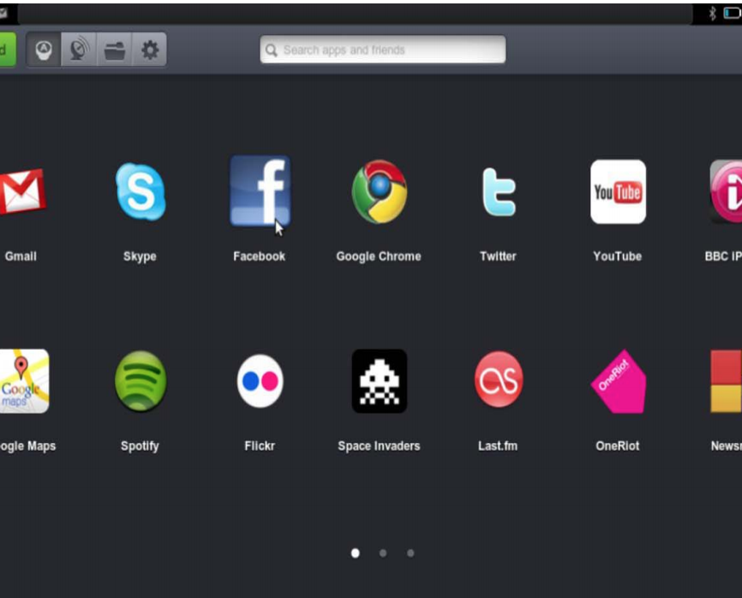
The Jolicloud Netbook OS

Slide 41
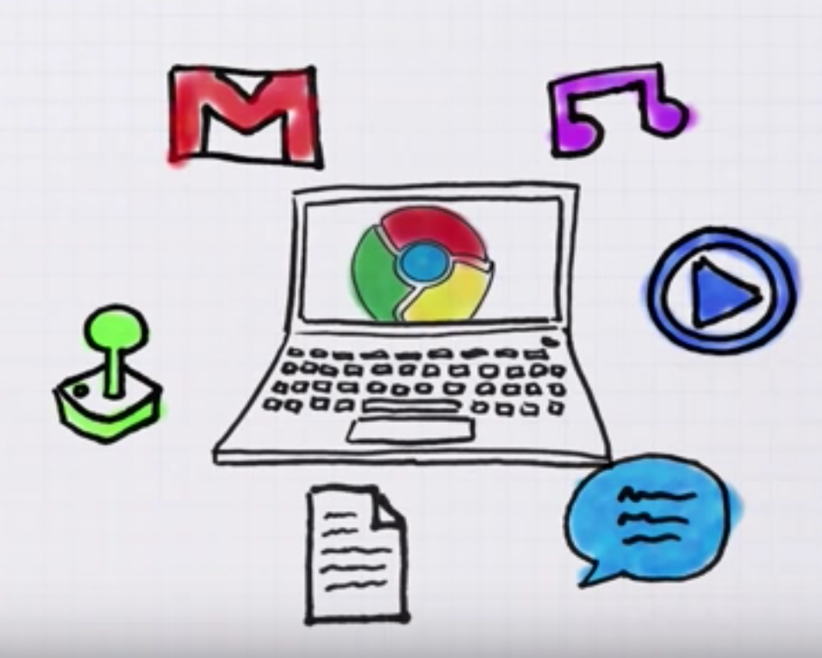
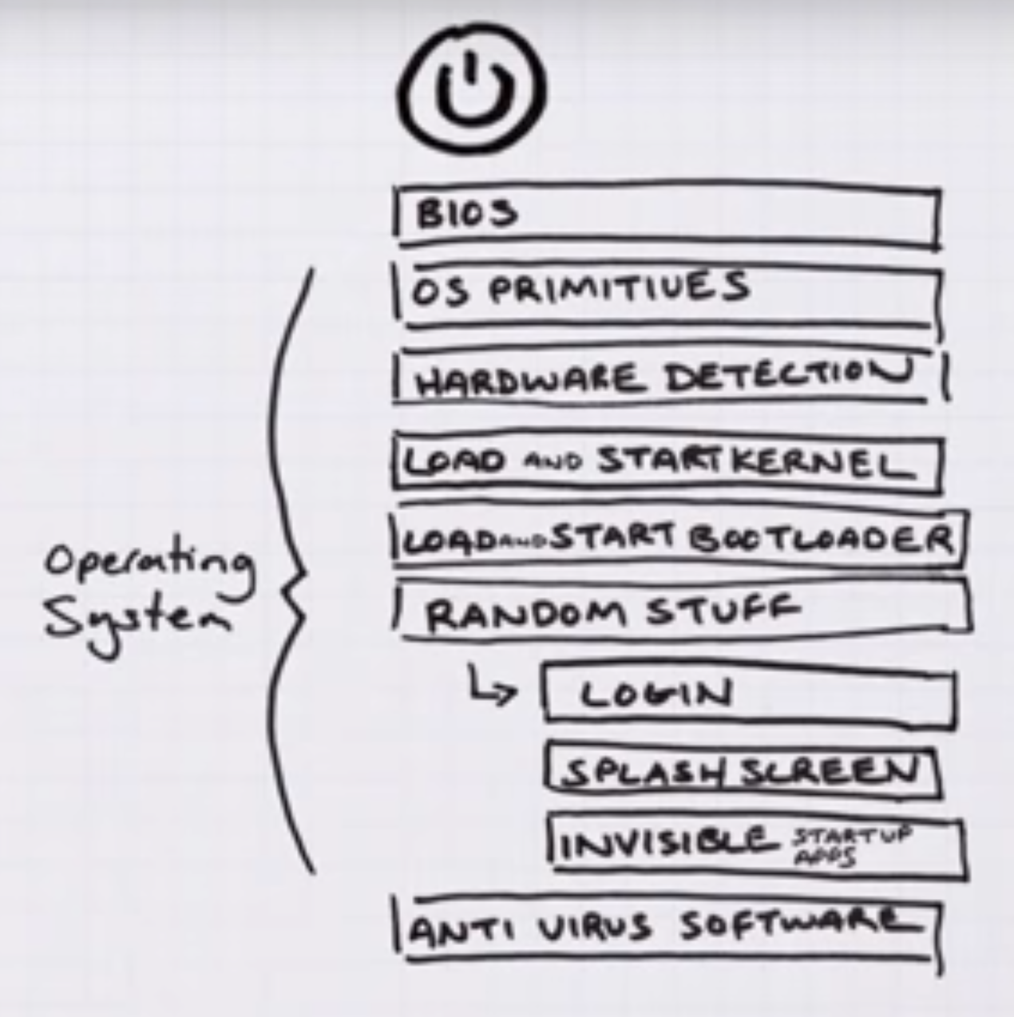
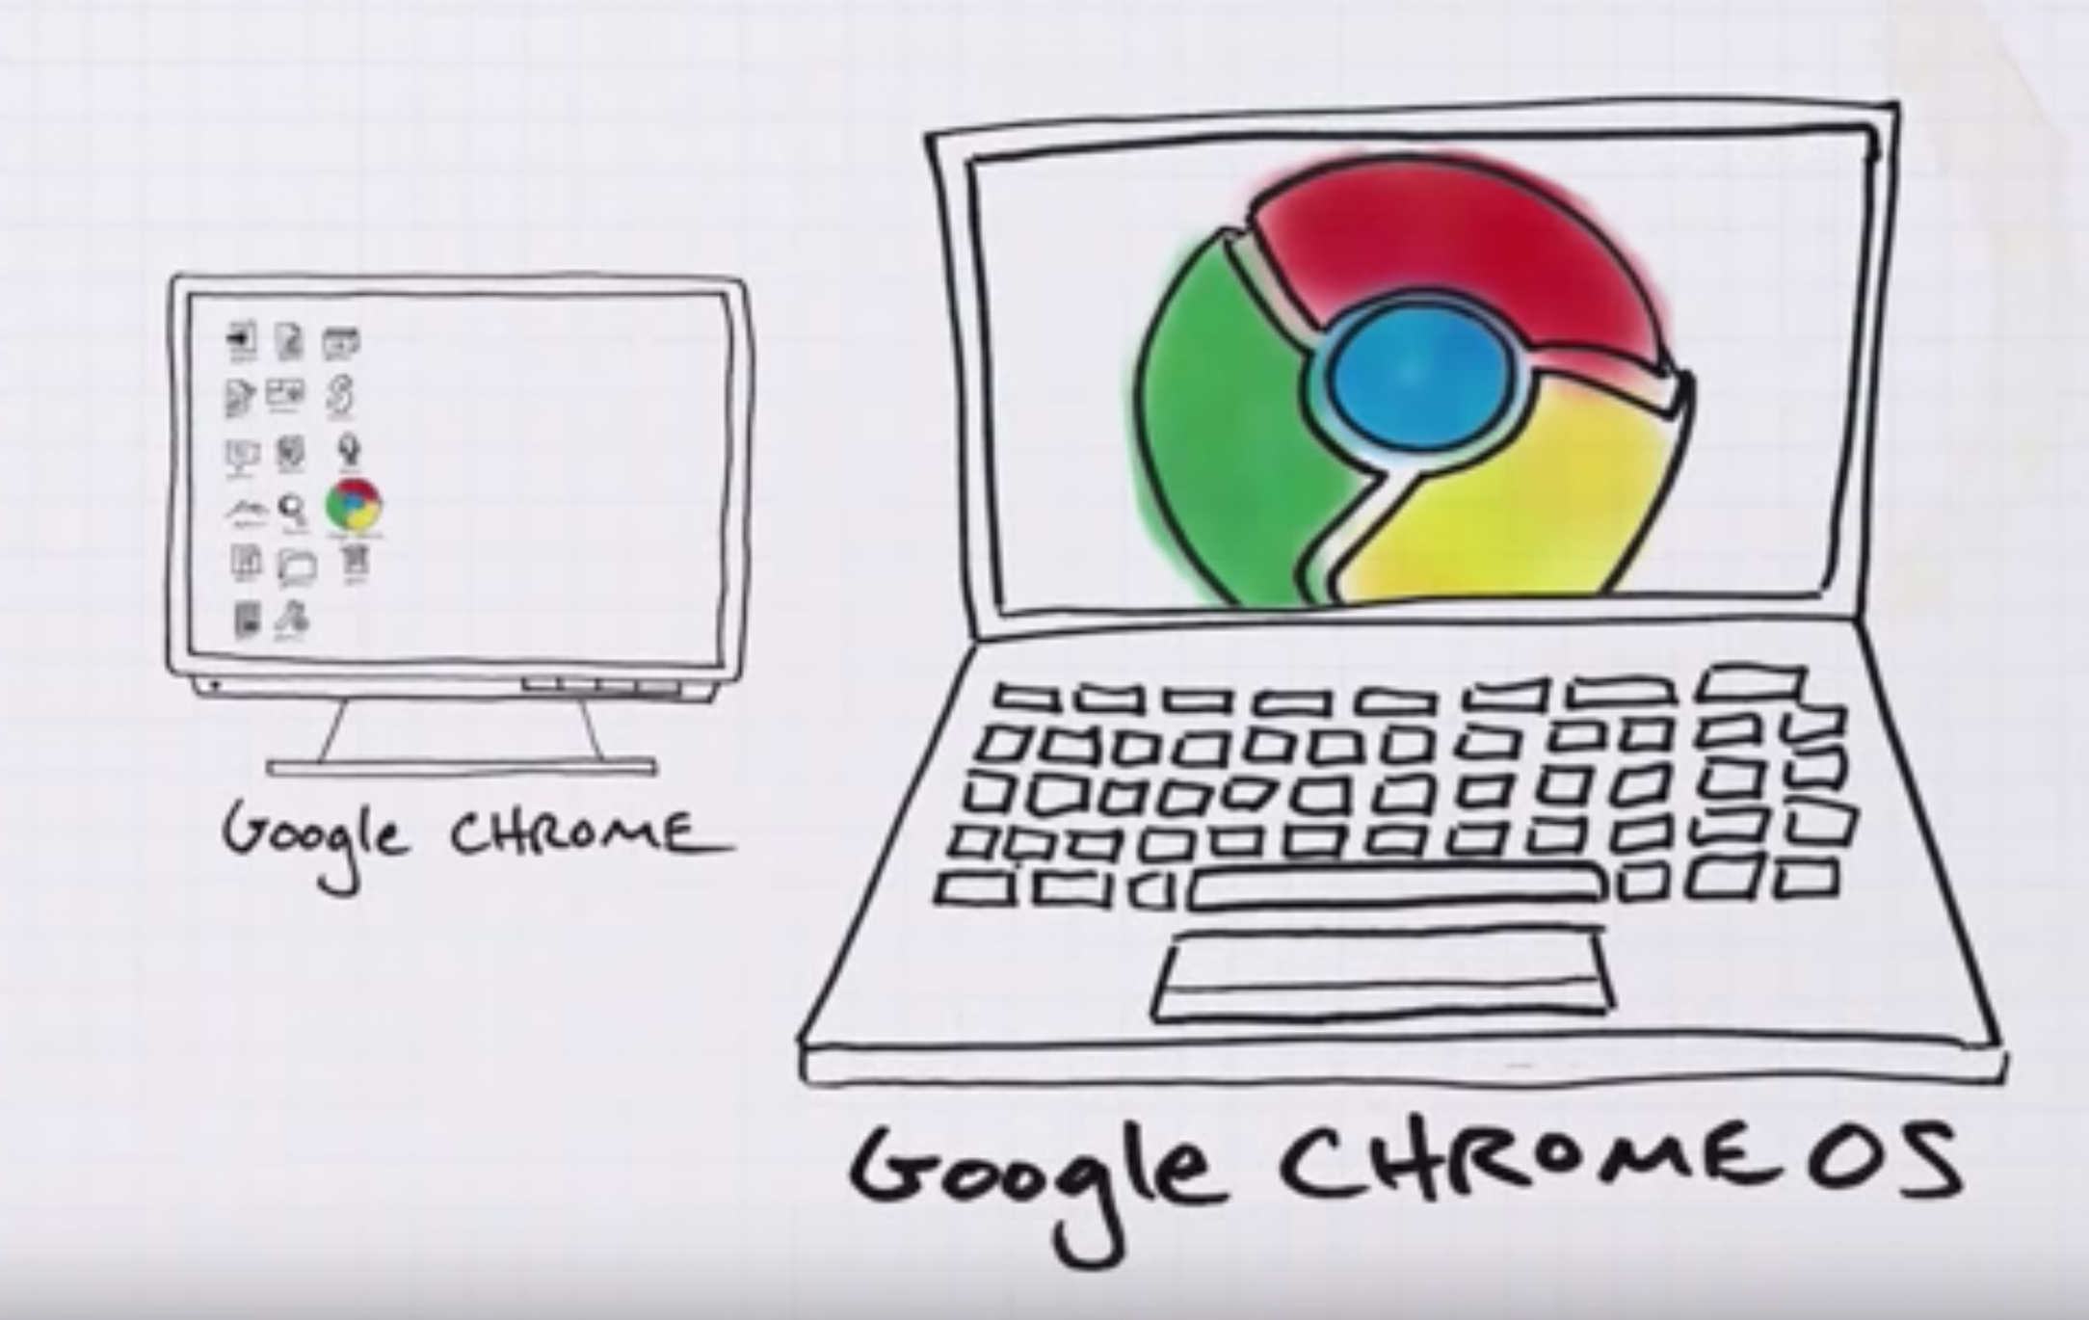
Google chrome OS
Chromium OS is an open-source project that aims to build an operating system that provides a fast, simple, and more secure computing experience for people who spend most of their time on the web

Slide 42
Summary
Cloud computing may be seen to be an extension of older Internet standards, but it includes some new architecture
Many of the important standards are aimed at managing transactions in the cloud and making components work together (SOAP, XML, and the various WSDL services)
A new class of cloud-connected clients may have major impact in changing the model by which people connect to the Internet and get their work done

